Slide 1



REAL Enjoyment Index
An Emotion-based Movie Ranker
Presented by:
Dabas, Rashika (101458141)
Dimaculangan, Roan Kathrina (101475014)
Ip, Chak Leung Vincent (101476107)
Suresh, Priyanka Yadhav (101473379)

Slide 2





TEAM
AI Engineer
Data Science Engineer
Full Stack Developer
ML Engineer
Suresh, Priyanka Yadhav
Dabas, Rashika
Dimaculangan, Roan Kathrina J.
Ip, Chak Leung Vincent

Slide 3
AGENDA
Business
Technical
1
Problem Statement
6
ML Canvas
2
Proposed Solution
7
Model Benchmarking
3
Our Approach
8
Model Deployment
4
Financial Plan
9
Challenges & Recommendations
5
SWOT Analysis
10
Demo

Slide 4
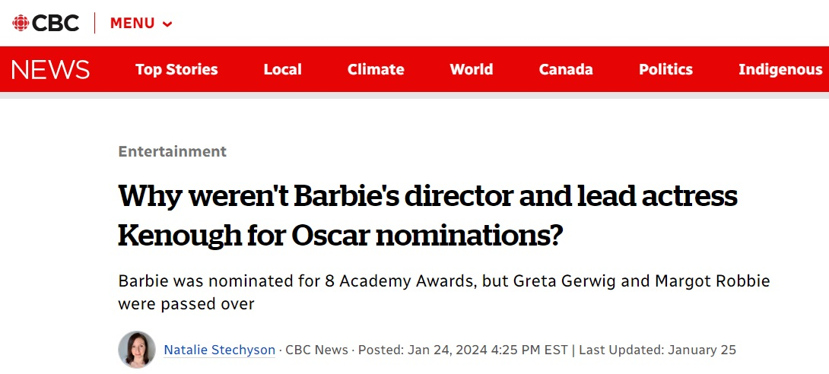
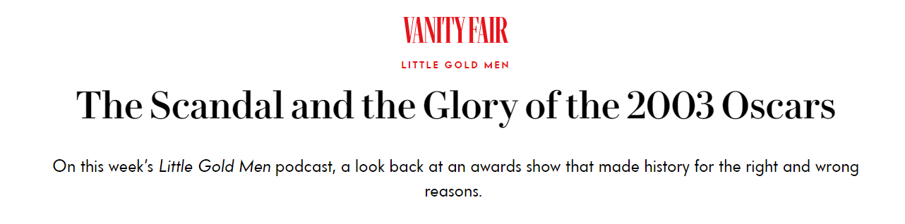
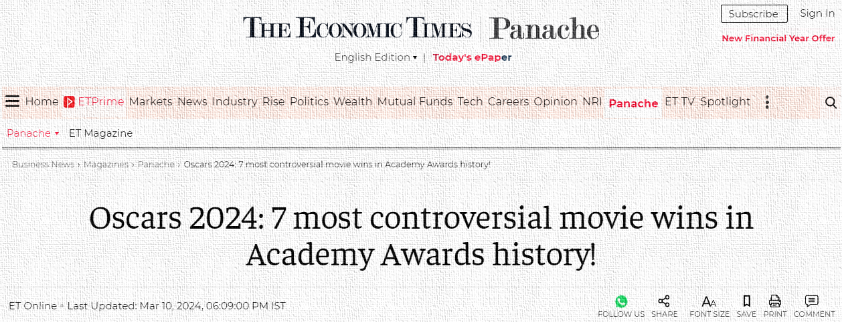
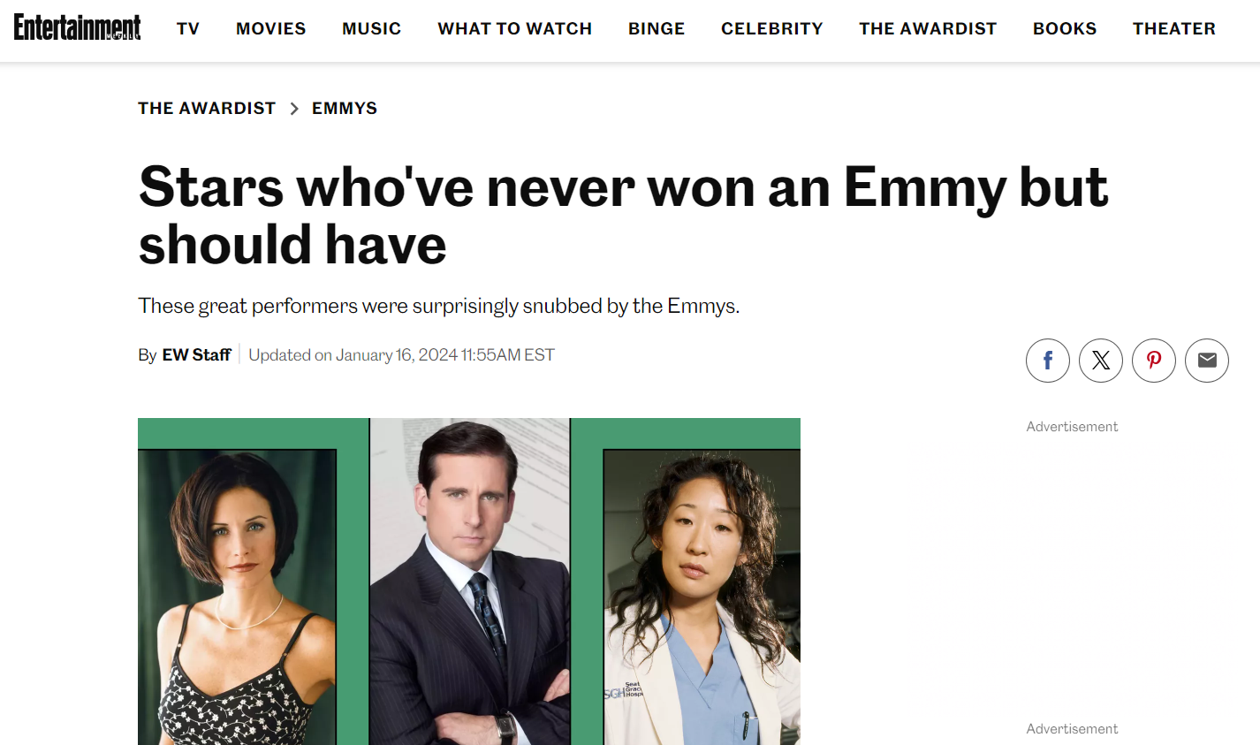



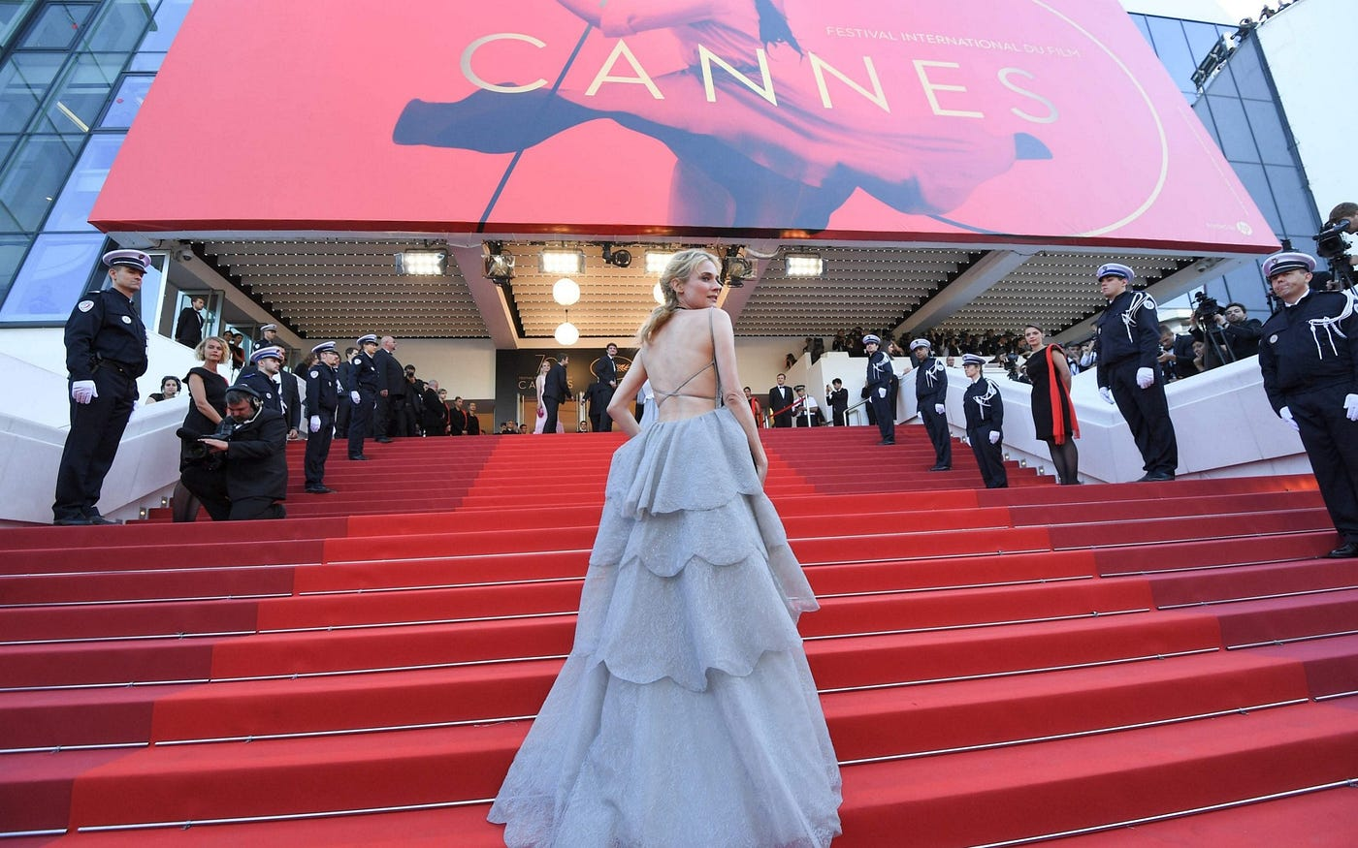
PROBLEM STATEMENT
Major Awards: Oscars, Berlinale, Venice FF, Cannes FF, TIFF
Old-fashioned: Voting/ Reviews/ Surveys (since 1929, Oscars)
Criticisms: biased, discrimination, scandals, controversies
Losing recognition from the public
People trust more in Data-driven intelligence, e.g. YouTube views
New technologies arise – AI Emotion Detection

Slide 5
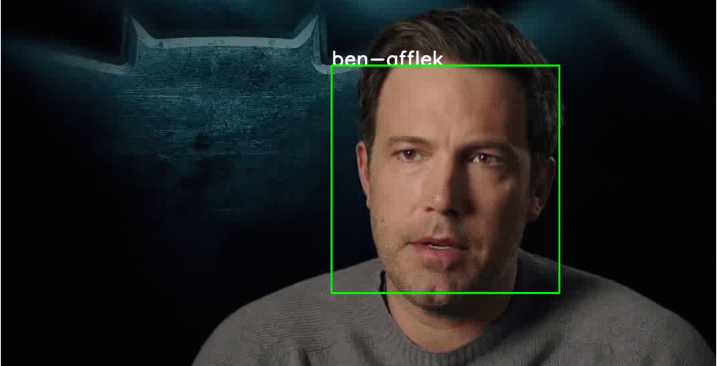
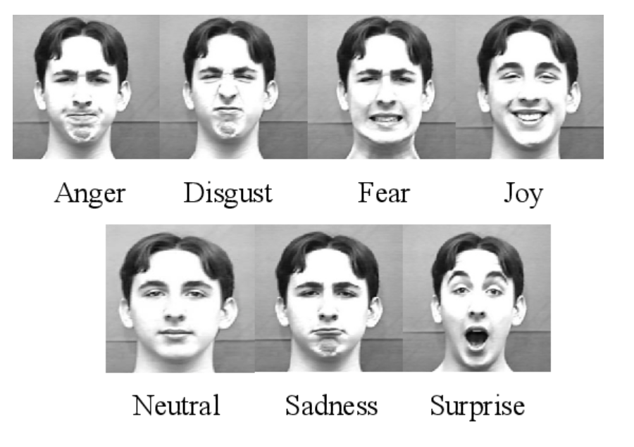
PROPOSED SOLUTION
Establish a Movie Ranker using Face Recognition and Emotion Detection technology
Devices set up at all theatres capturing faces of all audience throughout entire movie
Algorithm representing reactions from all audience
Benefits:
State-of-the-art – Utilizing latest AI and Big Data technology in establishing a reliable indicator
Objective – Taking into consideration reactions from every audience
Unbiased - Covers a wide representation for all ages, genders, races etc.
Trust from public – Generations of the new world establish more trust in data-driven indicators

Slide 6
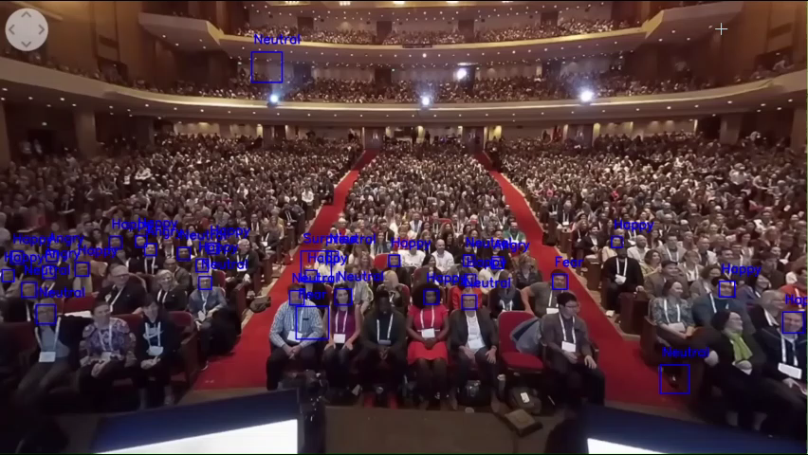



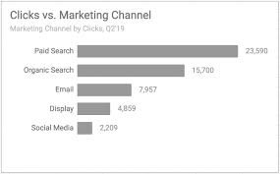
OUR APPROACH
② Algorithms calculating the Enjoyment score Version 1 algo: S.D. for each frame
① Using AI Face Recognition and Emotion Detection Technology to capture audience emotions
Happy
Happy
Happy
Happy
Angry
Sad
③ Rankings of Movies

Slide 7
All numbers in USD
For 1st financial year:
Financial Plan
Incomes
Annual Ceremony
$1.43M (~ 1% of Oscars)*
Income = 1.43M + 0.032M = 1.462M
Expense = 1.332M
Expense
Annual Ceremony Organisation Venue Rent (1) + (2) = $0.57M (~1% of Oscars)* Application Running Cost ($1000 x 12 months) $0.012M One-off Setup Fee (assume $750 x 1000) $0.75M
Total: $1.332M
Revenue: $0.13M
Advertising Partners and Sponsorship
REAL Enjoyment Index
Broadcasting Fee
Screening Fee from Filmmaker/ Distributor
Side Businesses
Total: $0.032M
Subscription for advanced analytics
from Filmmakers/ Reviewers/ Moviegoers
$0.01M
(assuming 100 users @$100/yr)
Consultation
from Filmmakers/ theme parks
$0.02M (estimate)
Other Applications
e.g. TED talks, education lectures etc.
$0.002M
(estimate)
*Reference: Market worth of Oscars: USD 143.5 Million (2023), Cost for Oscars Annual Ceremony: USD 56.9M (2023)

Slide 8
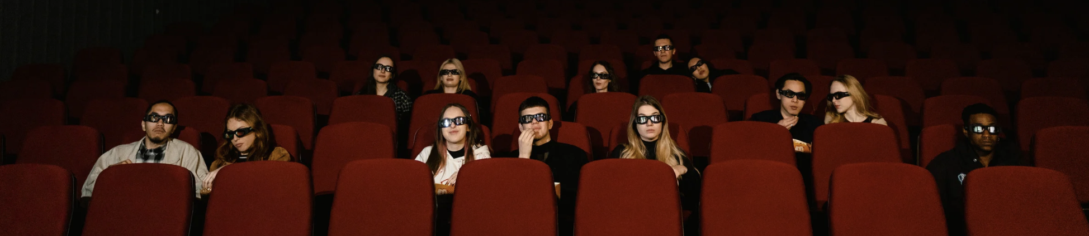
Strengths
Threats
Unique data collection tool for film industry
Offers valuable insights for various stakeholders
Enhances movie-going experience for people
S
T
Existing audience reaction data collection methods (surveys and test screenings)
Legal challenges regarding privacy rights
Competition from similar apps with new features
W
O
Weaknesses
Opportunities
Requires user adoption within the target market (studios and filmmakers)
May face privacy concerns regarding audience recording
Limited functionality in theatres with strict recording policies
Darkness affecting recording quality
Partnership with studios for data collection
Integration with existing movie review platforms
Expansion to other forms of entertainment (like live theatre, lectures or sporting events)

Slide 9


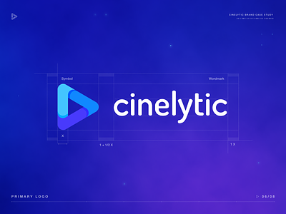



Market Research – Current Movie Rating Mechanisms
Online Review Platforms
Social Media
AI and ML

Slide 10

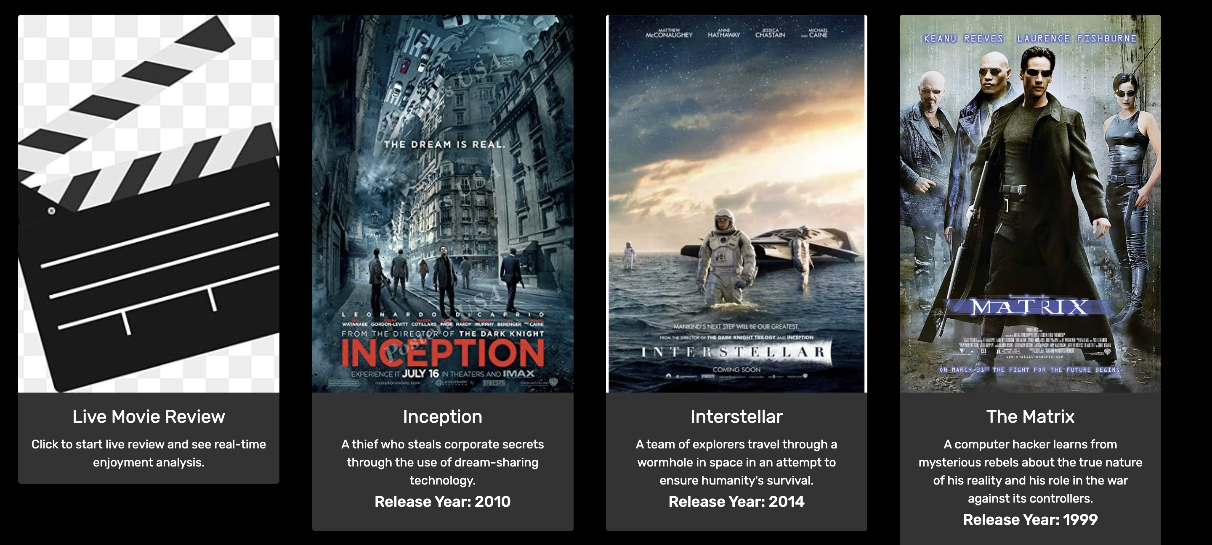

Slide 11
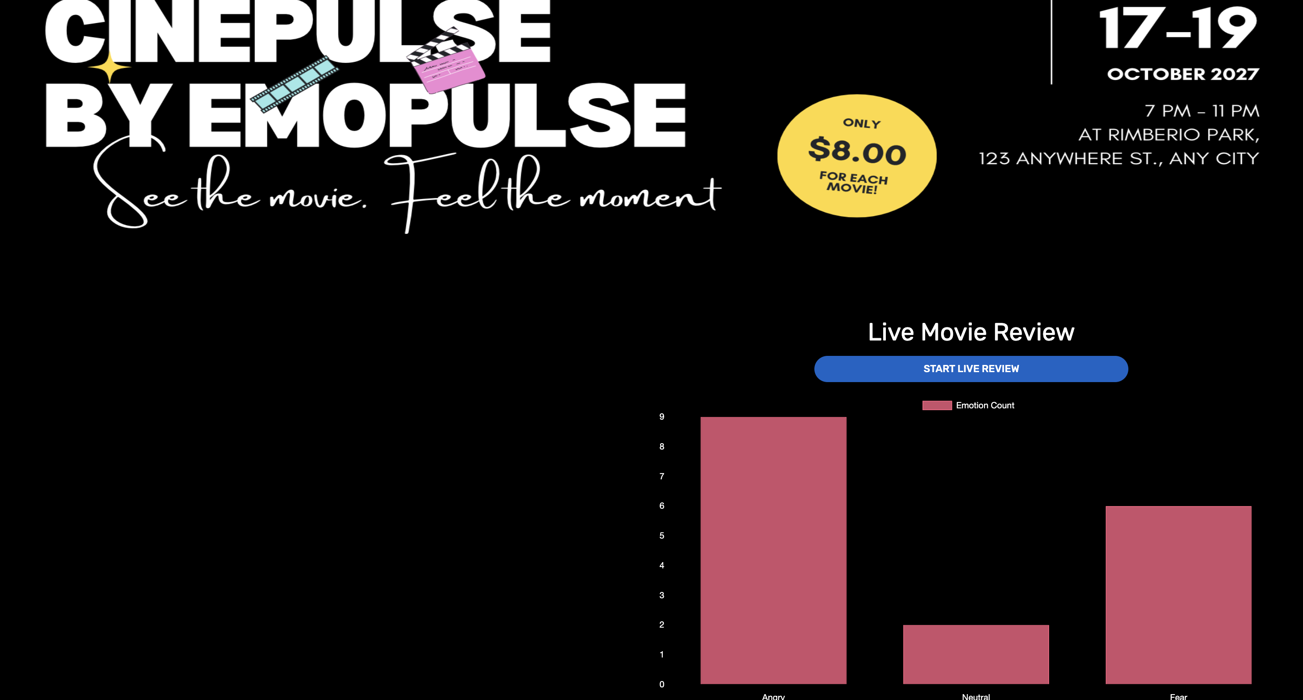
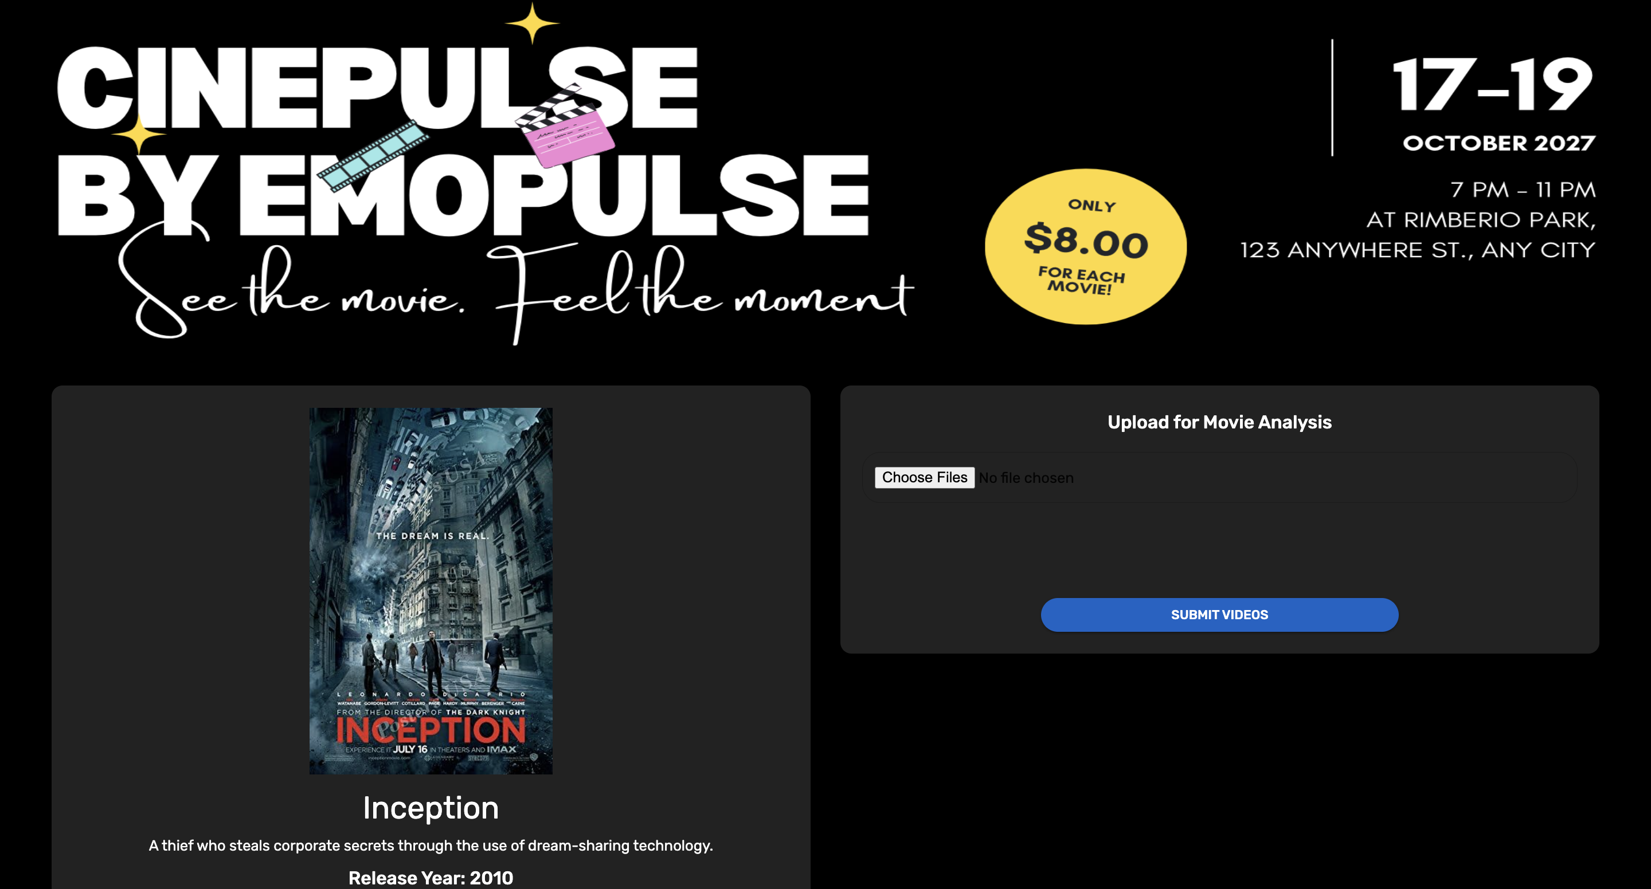
Product Description
A cutting-edge application designed to capture and analyze real-time emotional responses from moviegoers using facial recognition technology.
It's purpose is to provide filmmakers and cinemas with immediate insights into the emotional impact of their films, enhancing their ability to gauge success directly and in real-time

Slide 12
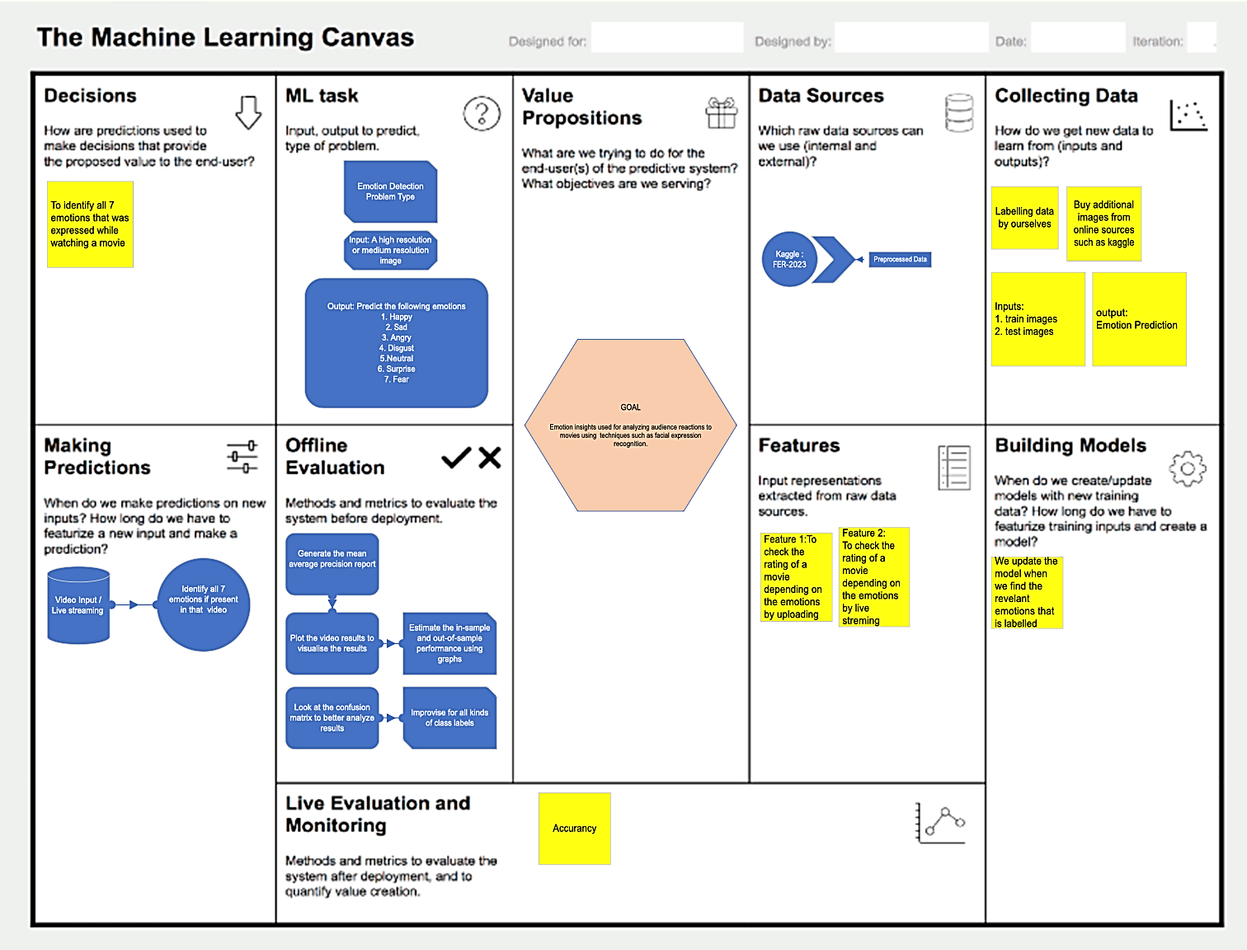
ML Canvas
End users: Film makers, distributors, moviegoers User- objectives: - To understand and differentiates movie by reliable movie rankings
- To understand better the reactions from audience on the movies

Slide 13
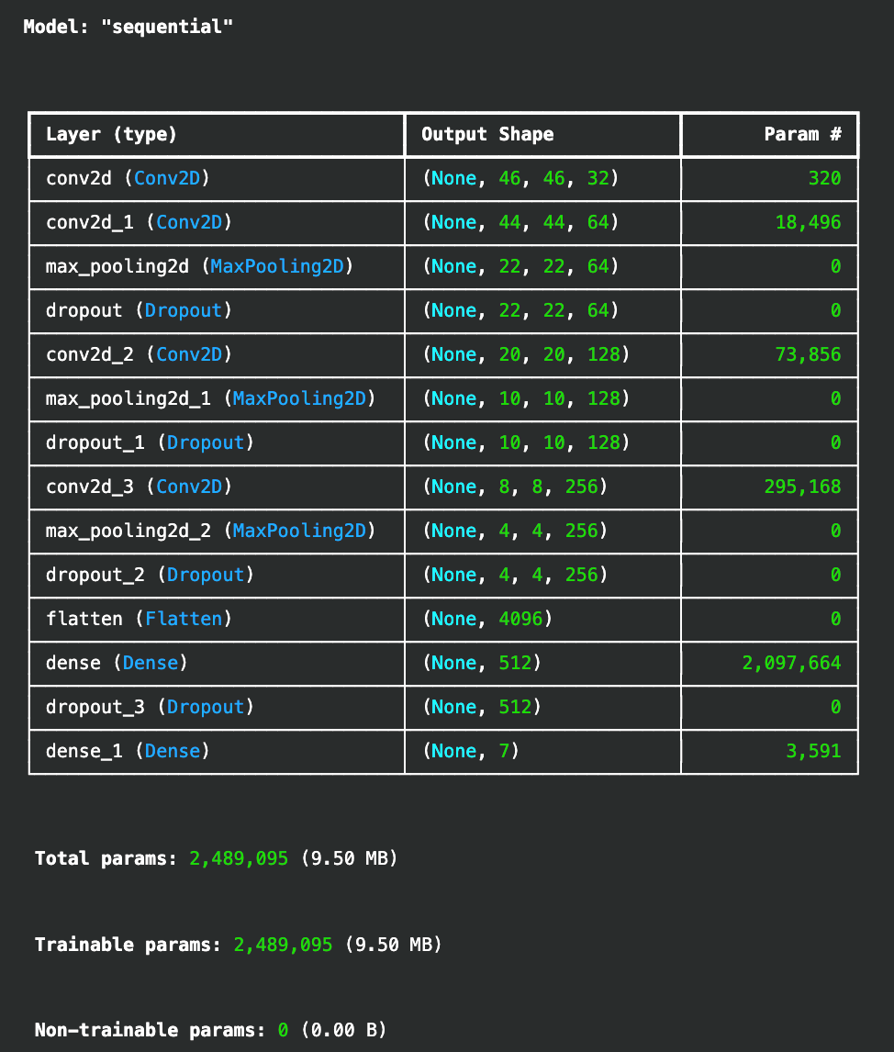
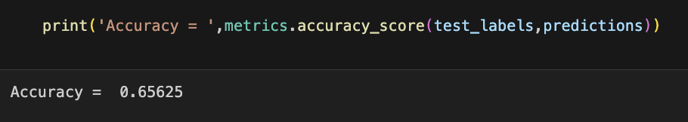
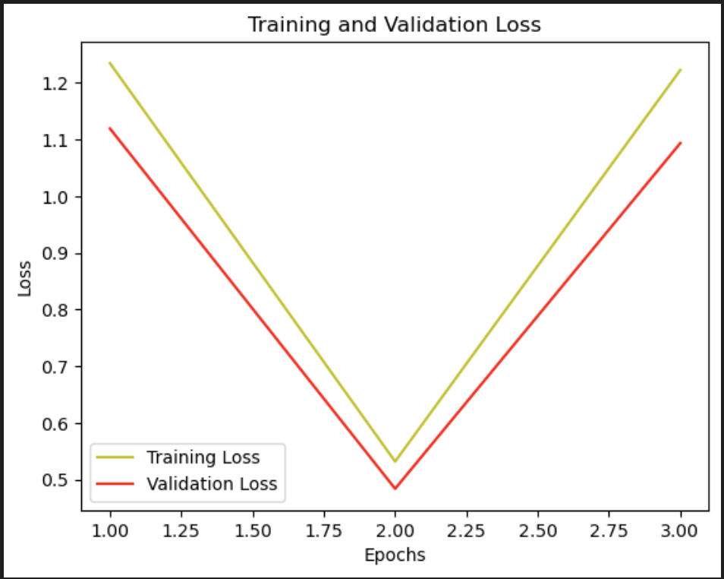
MODEL BENCHMARKING

Slide 14
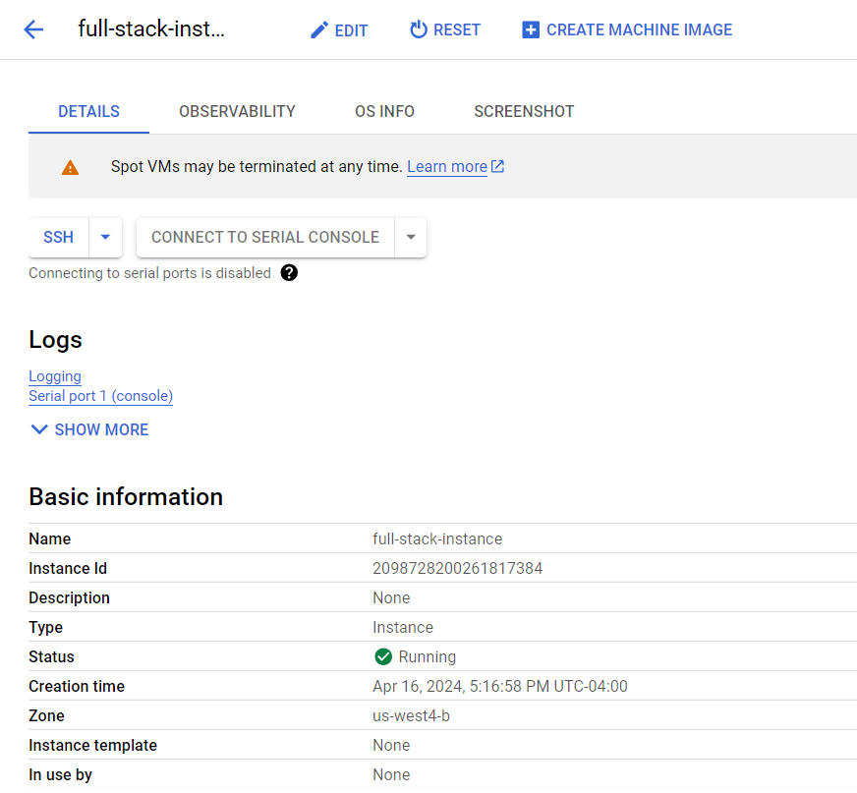
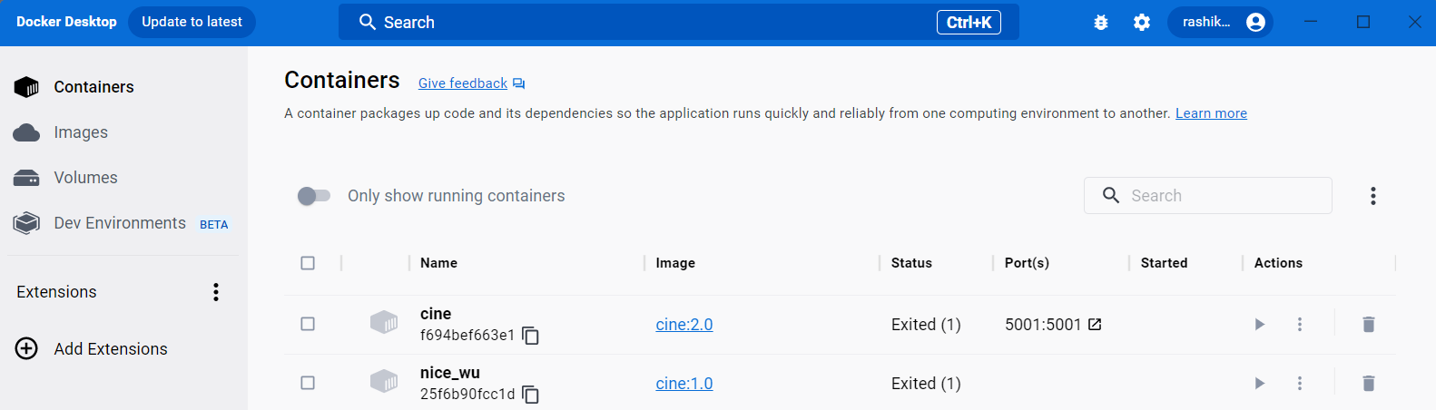
MODEL DEPLOYMENT
- Dockerization
- Deployment to GCP

Slide 15
DEMO

Slide 16
Thank You!

